Slide 1
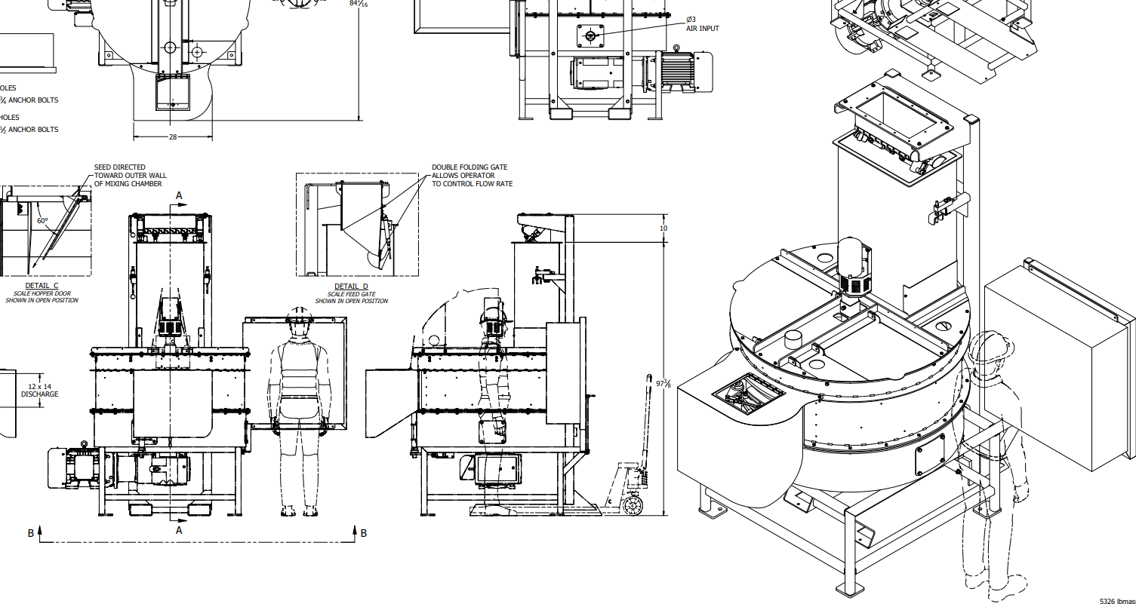
SedPell
RP52FT/CDB
52” Batch Seed Treater
Brought to you by:
Kannar Earth Science, Ltd.

Slide 2
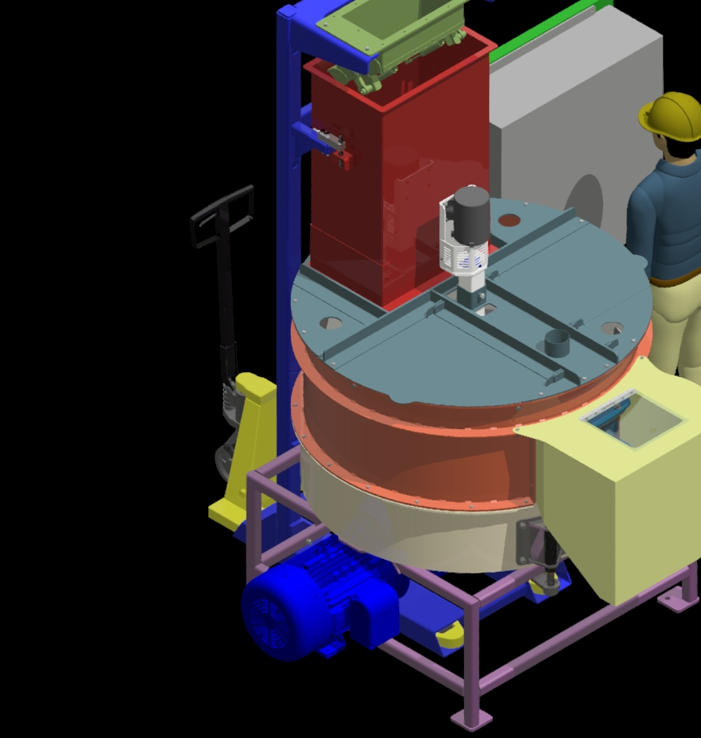
Treat seed like pro.
Fast, Accurate, Flexible.

Slide 3
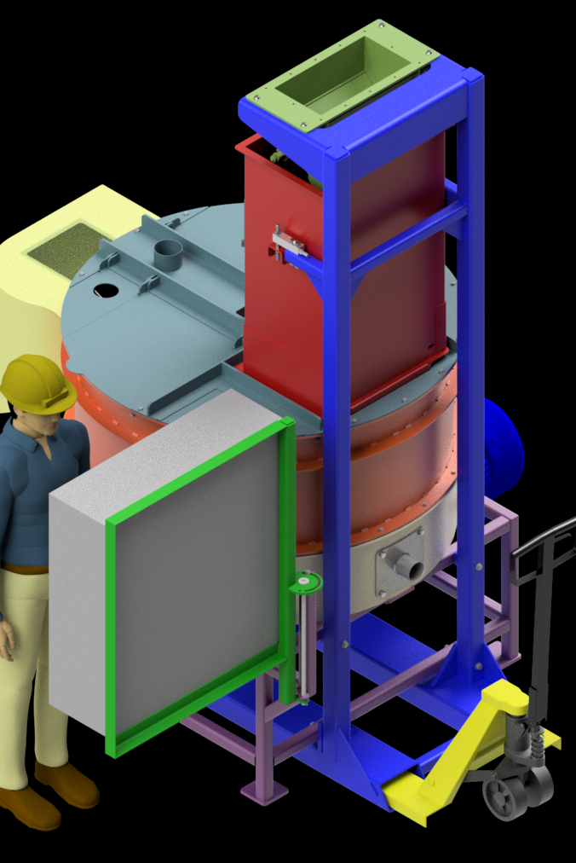
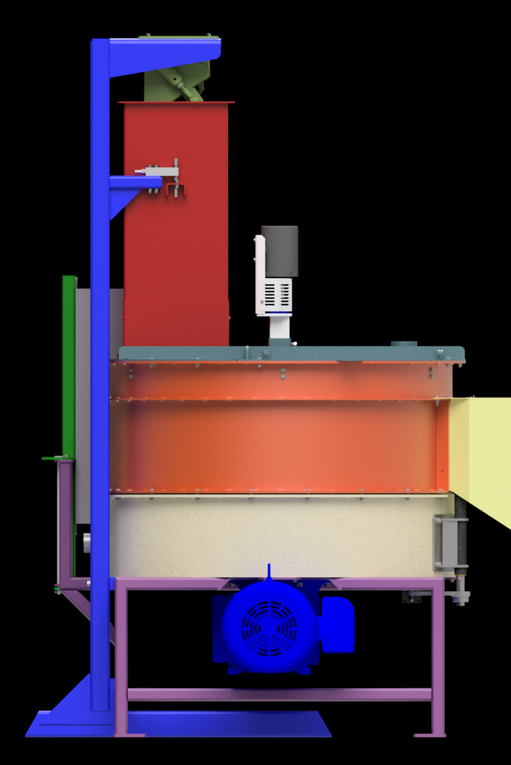
Robust construction and
easy maintenance

Slide 4
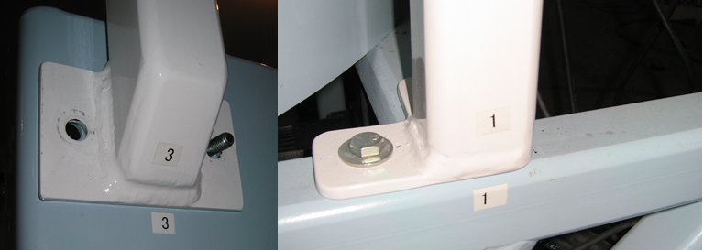
Ready, set, go
Up and running in record time
  CAD drawings of equipment component, suggested platform, made available ahead of time
  Ships “modular”, ready for plug and play

Slide 5
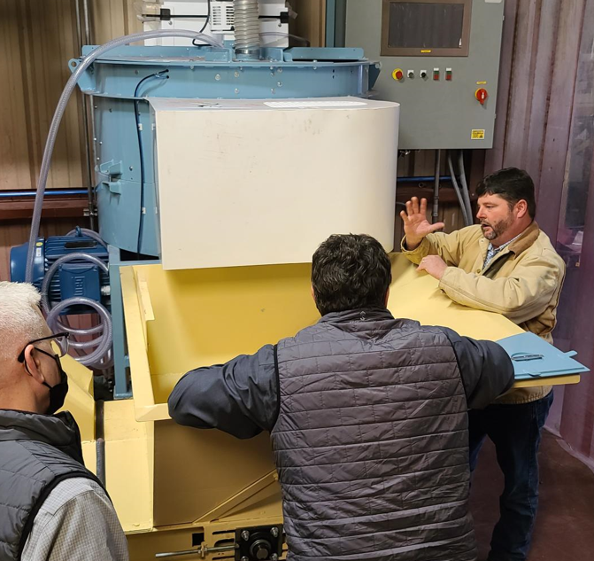
Sedpell earned the trust of the industry
Speed
  900 lb / min
  (300 lb’s / batch;
  20 seconds each)
Precision
  Film coat, encrusting or pelletizing
Maintenance
  Hours, not “days”
  Most parts and pieces readily available
  Room for equipment component movement and operator access
Robust construction
  No belts
  Built to last for decades of use

Slide 6
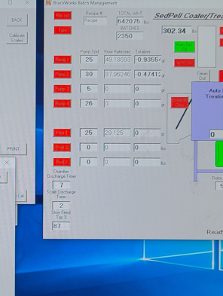
TREAT SEED IN NO TIME
Hybrid operating system for both build up and film treating
Operates on Windows 10/11 with 19" touchscreen
Troubleshooting and diagnostics available remotely

Slide 7
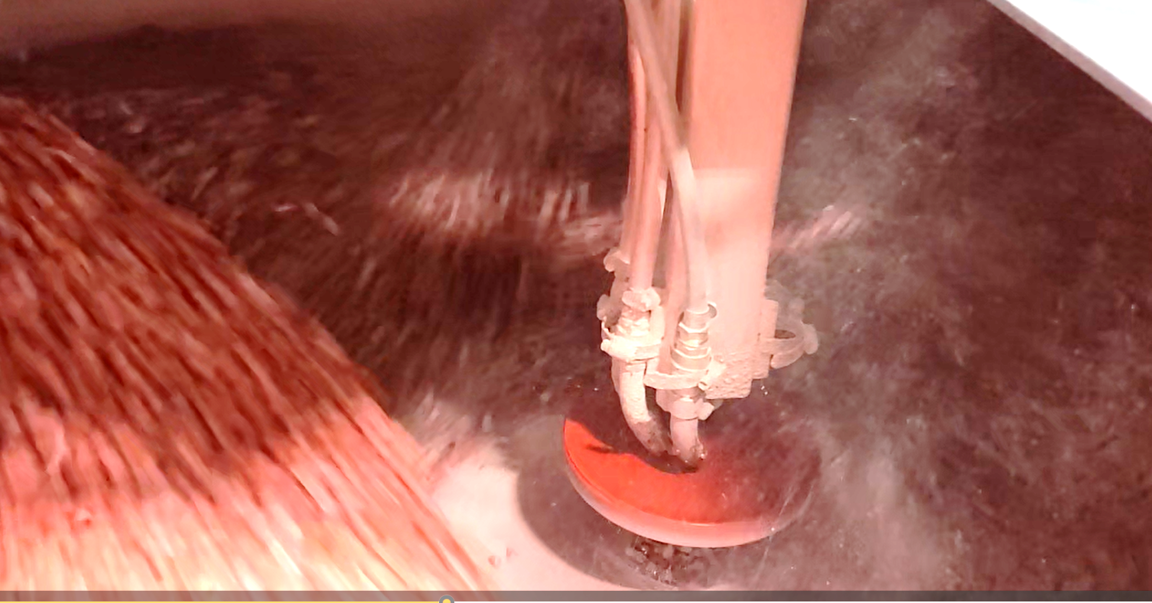
HIGH THROUGHPUT MADE EASY
Hi throughput seed batching scale with no risk or “bridging”
5-point mixing system minimizes batch time while being gentle on seed
7.5 cu. ft. capacity per batch
Treat 900 lbs per minute (seed being 40 lbs/cu. ft. and with as little as 20 sec/batch on film treatment)
Air seal between rotor and stator wall accelerate drying
Actuated mixing bar/discharge bar to rapidly discharge treated seed

Slide 8
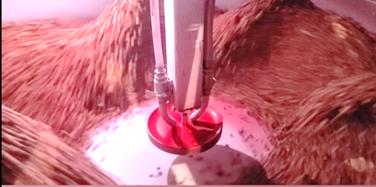
POWER REQUIREMENTS
RPD52FT/CDB
460 Volt 3phase 50 amps
2 cfm @ 90 psi clean dry air supply

Slide 9
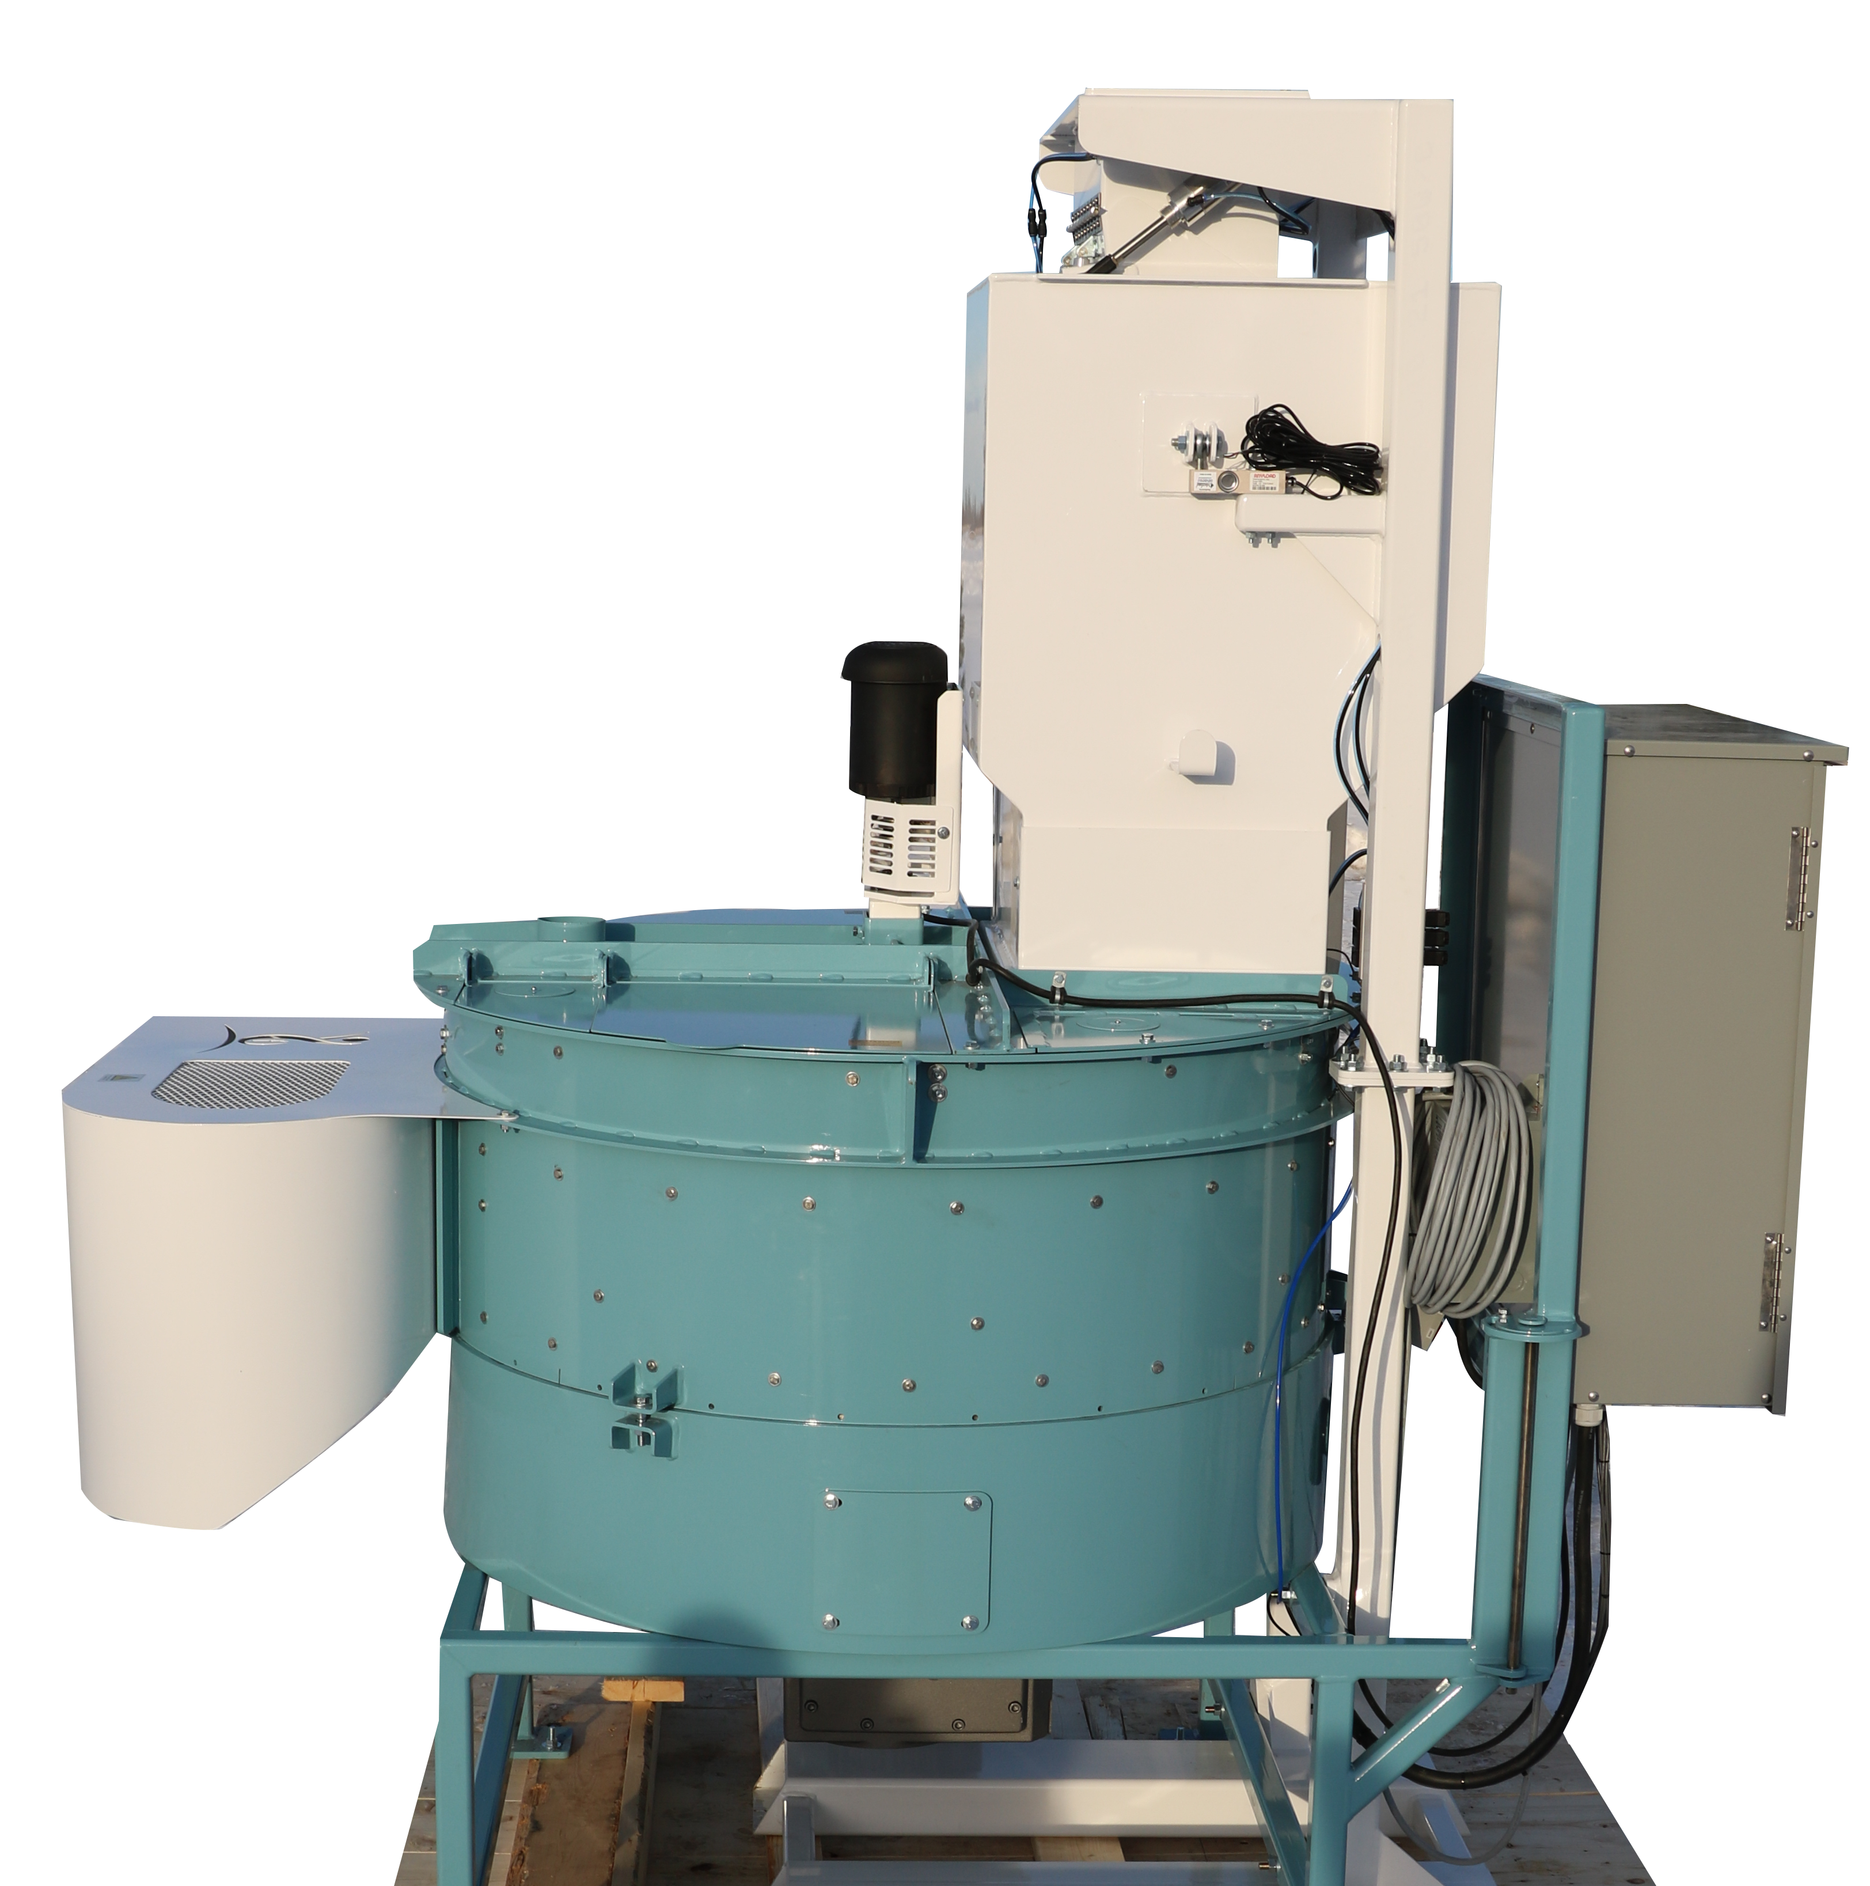
MAINTENANCE QUICK AND EASY
Tungsten coated rotor (easily rebuilt)
Mixing tub wear components are replaceable
Can be used for mild build up coatings up to 25%
Auto-Calibrating pump delivery system
Up to 5 pumps and 4 powder feeders
Easy disassembly for maintenance

Slide 10
Minimum space requirements
Height 98” Floor to bottom of seed inlet
Width 107” For operator and equipment
Deep 85” Add depth for seed belts
Additional room for chemical storage, and the weighing station required.

Slide 11


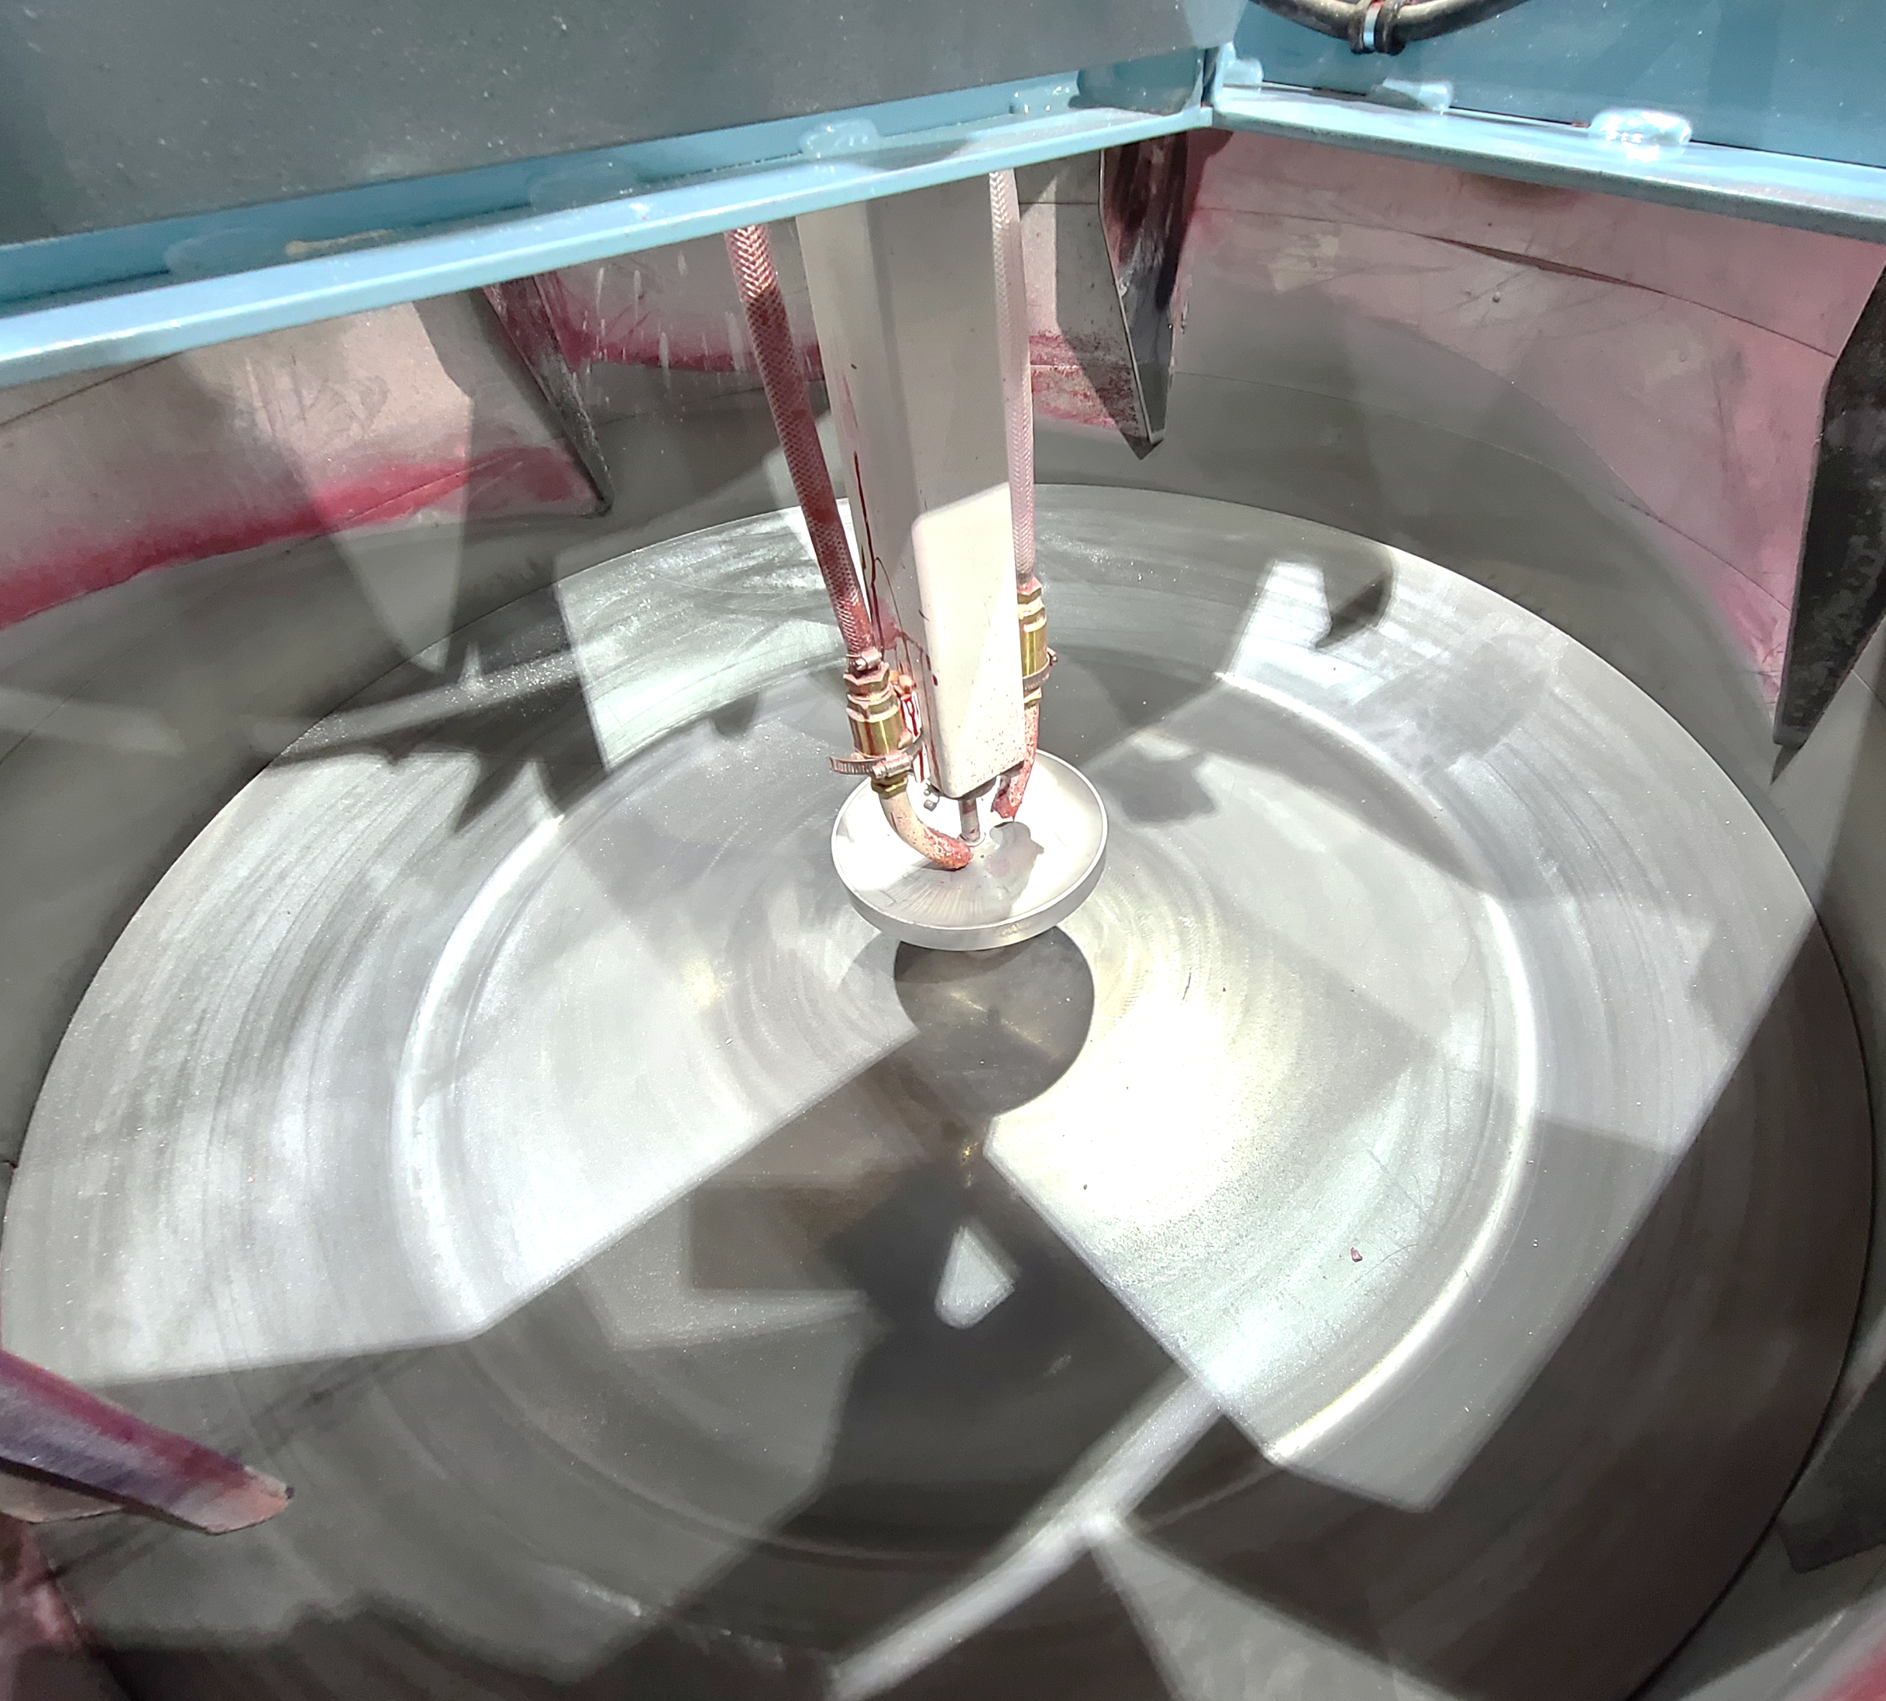
Get started today
info@kannargroup.com
https://kannargroup.com/equipment/
Tel: +1 (678) 475-1155

